Slide 1

Data Analyst Capstone Project
Mohd Waseem
Date:- 5/7/2026

Slide 2



OUTLINE
Executive Summary
Introduction
Methodology
Results
Visualization – Charts
Dashboard
Discussion
Findings & Implications
Conclusion
Appendix

Slide 3

EXECUTIVE SUMMARY
Point 1 : Analyzed job postings and developer survey datasets to identify technology and job market trends.
Point 2 : Explored current and future demand for programming languages, databases, platforms, and web frameworks.
Sub Points
Job market analysis using job postings
Technology trend analysis using developer survey
Demographic analysis of developers
Point 3 : Performed data cleaning, exploratory data analysis, and visualization using Python.
Point 4 : Built interactive dashboards using IBM Cognos Analytics.
Point 5 : Generated actionable insights and recommendations for technology adoption and career planning.

Slide 4

INTRODUCTION
Purpose of the report, Target Audience & Value of the analysis
Point 1: Analyze current technology usage and future technology trends.
Point 2: Identify the most in-demand programming languages, databases, platforms, and web frameworks.
Point 3: Present insights using data visualization and interactive dashboards.
Point 4: Support data-driven decision-making for career planning and technology adoption.
Sub Point 1: Target Audience: Students, developers, recruiters, and business professionals.
Sub Point 2: Tools Used: Python, SQL, IBM Cognos Analytics, and Microsoft PowerPoint.

Slide 5

METHODOLOGY
Data Sources, Data Collection & Data Wrangling Steps
Point 1: Collected data from job postings and the Stack Overflow Developer Survey dataset.
Point 2: Imported and explored the datasets using Python and SQL.
Point 3: Performed data cleaning and preprocessing to improve data quality.
Point 4: Conducted exploratory data analysis and created interactive dashboards using IBM Cognos Analytics.
Sub Point 1
Data wrangling included handling missing values, removing duplicates, and converting data types.
Sub Point 2
Visualizations were created using Python libraries and IBM Cognos to identify technology trends and demographic insights.

Slide 6

Results
This section presents the key findings of the analysis performed during the
capstone project. The following slides summarize the results obtained from
job market analysis, technology trends, data exploration, and dashboard
visualizations using Python and IBM Cognos Analytics.
The following slides present the key results and insights obtained from the
data analysis and dashboard visualizations.

Slide 7
JOB POSTINGS
Title: Job Postings Analysis
Bullet Points:
The chart shows the number of job postings
by technology.
The results are sorted in descending order.
Technologies with more job postings have
higher market demand.

Slide 8
POPULAR LANGUAGES
The chart compares average salaries for popular
programming languages.
Languages are sorted from highest to lowest salary.
Higher-paid languages indicate stronger earning potential
in the job market

Slide 9
PROGRAMMING LANGUAGE TRENDS
Summarize key trends shown in the charts.
Current Year
Next Year
JavaScript, Python, and SQL dominate as the most widely used languages. Go and Swift show strong mid-tier usage, while PHP and C++ remain relevant in legacy systems.
Python and JavaScript are projected to maintain top positions. Demand for Go and Rust is expected to rise due to cloud and systems programming growth, while PHP usage may continue to decline.

Slide 10
PROGRAMMING LANGUAGE TRENDS - FINDINGS & IMPLICATIONS
Findings:
Finding 1: JavaScript and Python consistently rank as the highest-paid and most-used languages across industries.
Finding 2: Go and Swift offer above-average salaries despite lower overall usage, indicating high demand for specialized skills.
Finding 3: Languages like PHP and C++ show lower average salaries, reflecting market saturation.
Implications:
Implication 1: Developers should prioritize learning Python and JavaScript to maximize employability and earning potential.
Implication 2: Investing in Go or Swift skills can lead to higher compensation in niche but growing markets.
Implication 3: Organizations should plan transitions away from lower-paying legacy languages to stay competitive in talent acquisition.

Slide 11
DATABASE TRENDS
Summarize key trends shown in the charts.
Current 10 Years
Next 10 Years
MySQL, PostgreSQL, and SQLite are the most widely used databases among developers in the current year. Microsoft SQL Server and MongoDB also maintain strong adoption, particularly in enterprise environments, while Oracle continues to play an important role in large organizations despite being less common among individual developers.
PostgreSQL and MongoDB are expected to gain wider adoption due to their scalability and cloud support, while MySQL is projected to remain one of the most preferred databases. At the same time, interest in Redis and other cloud-native databases is likely to increase, whereas Oracle adoption may gradually decline in modern application development.

Slide 12
DATABASE TRENDS - FINDINGS & IMPLICATIONS
Findings
Finding 1: MySQL, PostgreSQL, and SQLite are the most widely used databases.
Finding 2: PostgreSQL and MongoDB show strong future growth and increasing developer interest.
Finding 3: Oracle remains important for enterprise applications, while Redis and cloud-native databases are gaining popularity.
Implications
Implication 1: Learning PostgreSQL and MySQL can improve career opportunities in database management.
Implication 2: MongoDB and cloud-native databases are valuable skills for modern application development.
Implication 3: Organizations should adopt scalable and cloud-compatible databases to meet future technology demands.

Slide 13
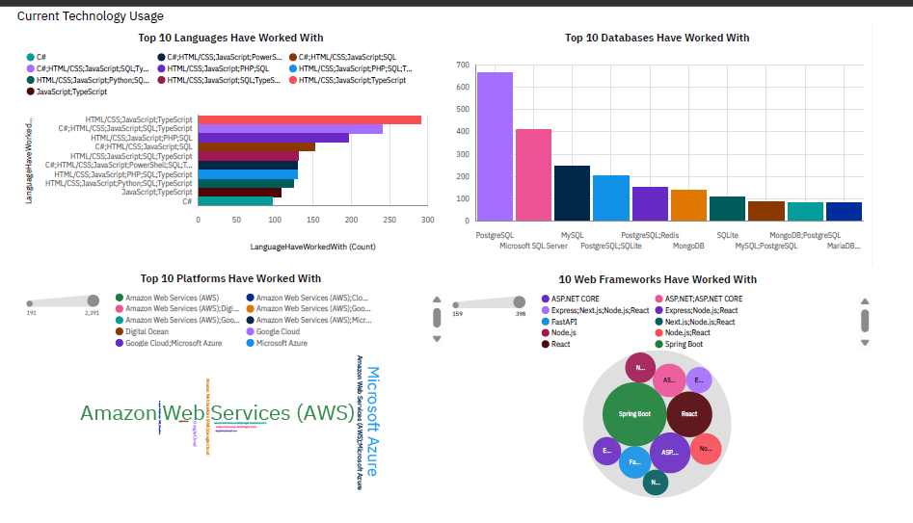
DASHBOARD TAB 1: Current Technology Usage
Summary
The current technology usage dashboard shows that JavaScript,
HTML/CSS, SQL, and Python are the most widely used programming
languages among developers. PostgreSQL, Microsoft SQL Server, and MySQL
are the leading databases in current use. Among cloud platforms,
Amazon Web Services (AWS) and Microsoft Azure dominate the market,
while Spring Boot, React, and ASP.NET Core are the most commonly used
web frameworks These findings indicate that full-stack development and cloud
technologies continue to play a significant role in modern software development.

Slide 14
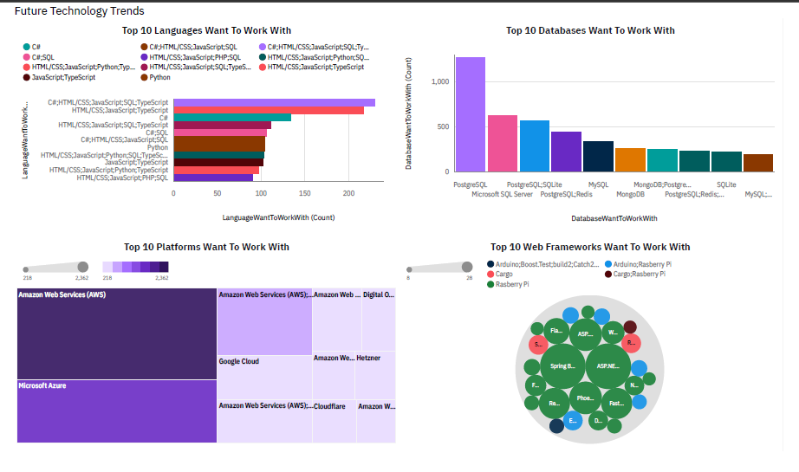
DASHBOARD TAB 2: Future Technology Trends
Summary
The future technology trends dashboard highlights that Python, JavaScript, and SQL are expected to remain the most preferred programming languages. PostgreSQL continues to be the most desired database, followed by Microsoft SQL Server and MySQL. Developers also show increasing interest in AWS, Microsoft Azure, and Google Cloud for cloud computing. The popularity of ASP.NET Core, Spring Boot, and React suggests continued growth in modern web application development.

Slide 15
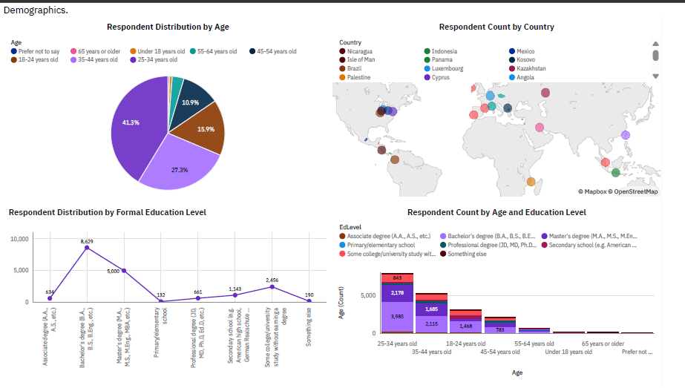
DASHBOARD TAB 3: Demographics
Summary
The demographics dashboard reveals that the majority of respondents belong to the 25–34 years age group, followed by 35–44 years. Most respondents hold a Bachelor’s degree, indicating a highly educated developer community. The country distribution shows participation from multiple regions worldwide, demonstrating the global nature of the survey. The relationship between age and education suggests that the largest proportion of experienced professionals falls within the 25–34 age category.

Slide 16

DISCUSSION
The analysis indicates that Python, JavaScript, SQL, PostgreSQL, AWS, and modern web frameworks such as React and Spring Boot continue to dominate both current usage and future technology preferences. These technologies remain highly valuable for developers seeking career growth and organizations planning future technology adoption. The demographic analysis further shows that the global developer community is largely composed of young, well-educated professionals, highlighting strong demand for modern technical skills.

Slide 17
OVERALL FINDINGS & IMPLICATIONS
Findings
Finding 1: JavaScript, Python, SQL, and PostgreSQL are the most widely used and preferred technologies.
Finding 2: AWS, Microsoft Azure, and Google Cloud continue to dominate cloud platform adoption.
Finding 3: Most survey respondents are aged 25–34 years and hold a Bachelor’s degree, representing a skilled developer workforce.
Implications
Implication 1: Developers should focus on Python, JavaScript, SQL, and PostgreSQL to improve career opportunities.
Implication 2: Organizations should invest in cloud technologies such as AWS and Azure to remain competitive.
Implication 3: Continuous learning of modern technologies and cloud platforms is essential to meet future industry demands.

Slide 18

CONCLUSION
Point 1: The analysis identified the current and future trends in programming languages, databases, cloud platforms, and web frameworks.
Point 2: Python, JavaScript, PostgreSQL, and AWS emerged as the most popular and in-demand technologies across the analysis.
Point 3: Interactive dashboards and visualizations provided valuable insights into developer preferences, technology adoption, and demographic patterns.
Point 4: The project demonstrates how data analytics and visualization can support informed career decisions and technology adoption for individuals and organizations.

Slide 19

APPENDIX
Additional Charts
Histogram of Yearly Compensation
Scatter Plot of Compensation vs. Job Satisfaction
Bubble Plot of Technology Preferences by Age
Pie Charts for Programming Languages and Databases
Additional Tables
Top 10 Programming Languages
Top 10 Databases
Summary Statistics of Survey Data
Supporting Materials
IBM Cognos Dashboard Screenshots
Python Analysis Outputs
Job Postings and Technology Trend Tables

